Slide 1
UNSUPERVISED MACHINE LEARNING
K-Means Clustering
Detailed concepts, mathematics, algorithm & Python
From centroid intuition to a customer segmentation mini-project
Includes complete practical code for customers.csv
UNSUPERVISED LEARNING • CUSTOMER SEGMENTATION
1

Slide 2
K-MEANS CLUSTERING
What this presentation covers
Detailed coverage of the first four tutorial points plus the complete customer segmentation workflow.
1. Definition
2. Intuition
3. Mathematics
What K-Means is, where it is used, and what a cluster means.
The four-stage loop: initialize, assign, update, repeat.
Euclidean distance, centroid calculation, and WCSS objective.
4. Algorithm
5. Hands-on code
Pseudocode, convergence, initialization, and limitations.
Load data, scale features, fit, evaluate, profile, and visualize.
UNSUPERVISED LEARNING • CUSTOMER SEGMENTATION
2

Slide 3
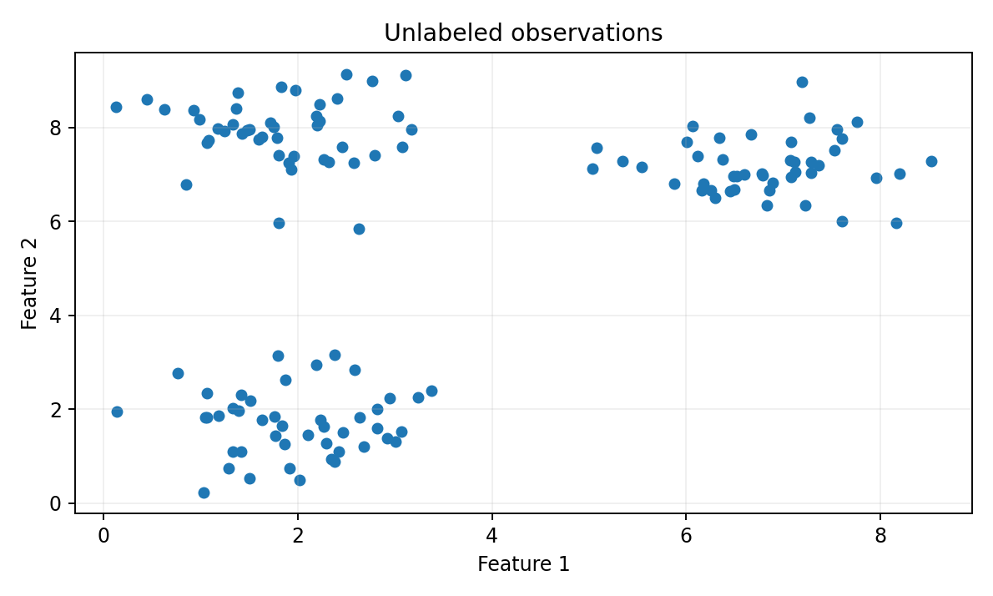
K-MEANS CLUSTERING
1. What is K-Means clustering?
A partition-based unsupervised learning algorithm.
K-Means divides observations into K groups called clusters.
• K is chosen before the model is fitted.
• Each observation belongs to exactly one cluster.
• Each cluster is represented by a centroid (the mean position).
• The algorithm tries to keep points close to their own centroid.
Example
Group customers using age, annual income, and spending score.
UNSUPERVISED LEARNING • CUSTOMER SEGMENTATION
3

Slide 4
K-MEANS CLUSTERING
What can a customer cluster mean?
Cluster labels are discovered by the algorithm; their business meaning is interpreted afterwards.
Cluster A
Cluster B
Cluster C
Potentially lower income and lower spending.
Potentially higher income and higher spending.
Potentially higher income and lower spending.
• These are examples, not guaranteed outcomes—the real profiles depend on the dataset.
• Cluster numbers such as 0, 1, and 2 are arbitrary identifiers, not rankings.
UNSUPERVISED LEARNING • CUSTOMER SEGMENTATION
4

Slide 5
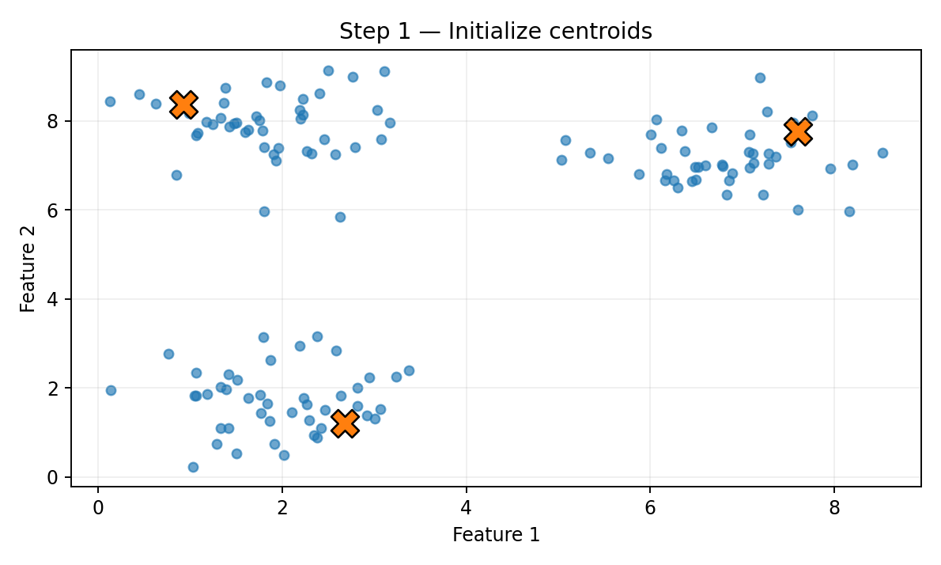
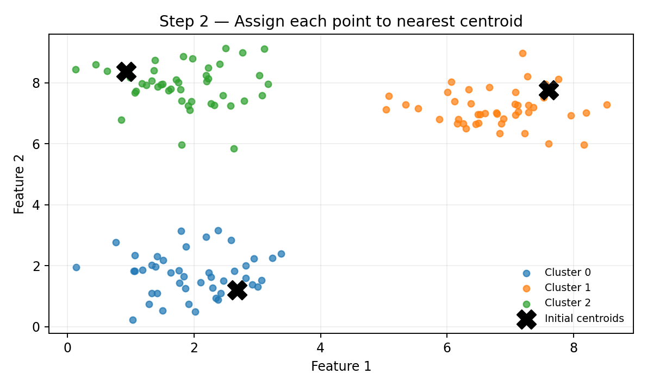
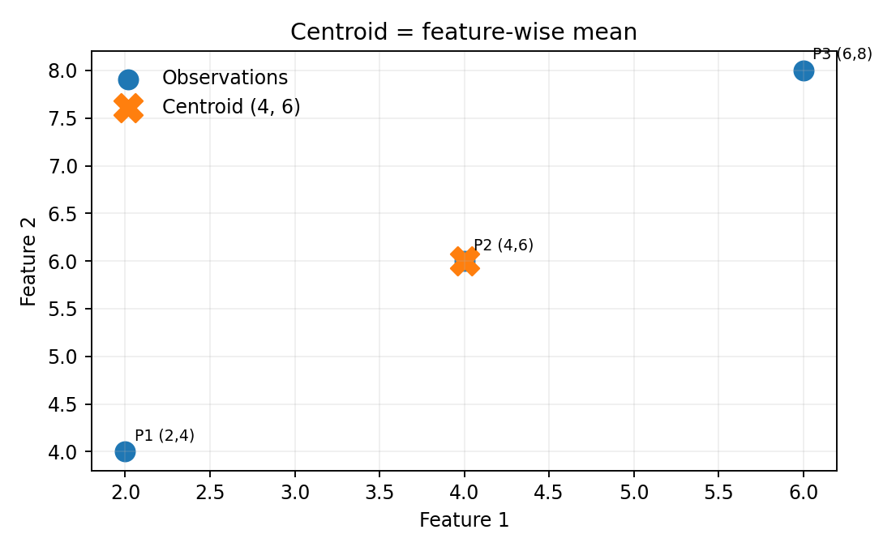
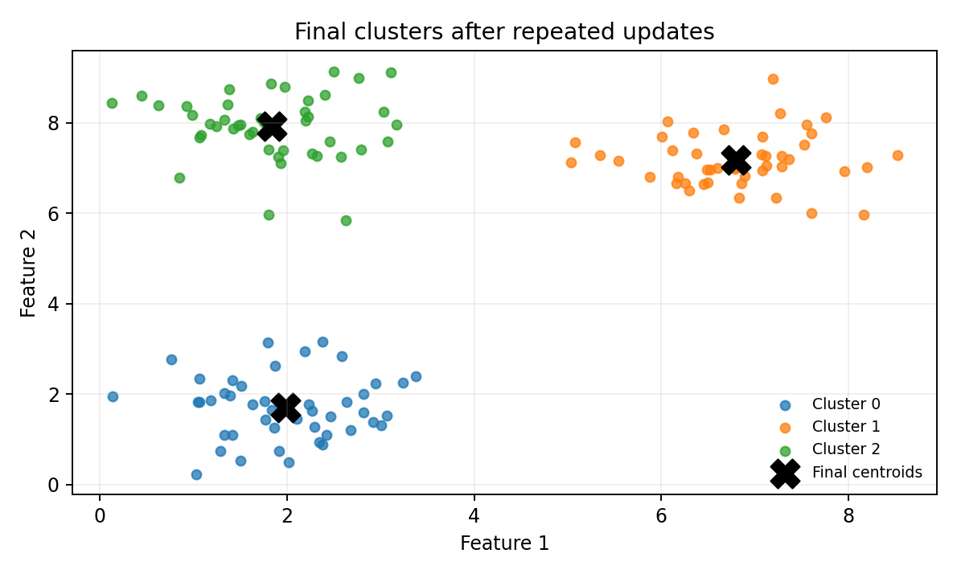
K-MEANS CLUSTERING
2. How K-Means works intuitively
The model repeatedly assigns points to their nearest center and updates the centers.
1. Initialize
Choose K starting centroids.
2. Assign
Find the nearest centroid for every observation.
3. Update
Calculate the mean of points in each cluster.
4. Repeat
Stop when centers stabilize or the iteration limit is reached.
UNSUPERVISED LEARNING • CUSTOMER SEGMENTATION
5

Slide 6
K-MEANS CLUSTERING
Step 1 — Initialize centroids
Choose K initial centers; K-Means++ is generally preferred over naive random initialization.
• The starting positions influence the final solution.
• K-Means++ spreads initial centers using distances from existing centers.
• Multiple initializations help reduce sensitivity to a poor start.
UNSUPERVISED LEARNING • CUSTOMER SEGMENTATION
6

Slide 7
K-MEANS CLUSTERING
Step 2 — Assign each observation
Every point is assigned to the nearest centroid using a distance measure.
Nearest center
Calculate each point’s distance to all K centroids and choose the smallest.
Result
Every observation receives a cluster label from 0 to K−1.
UNSUPERVISED LEARNING • CUSTOMER SEGMENTATION
7

Slide 8
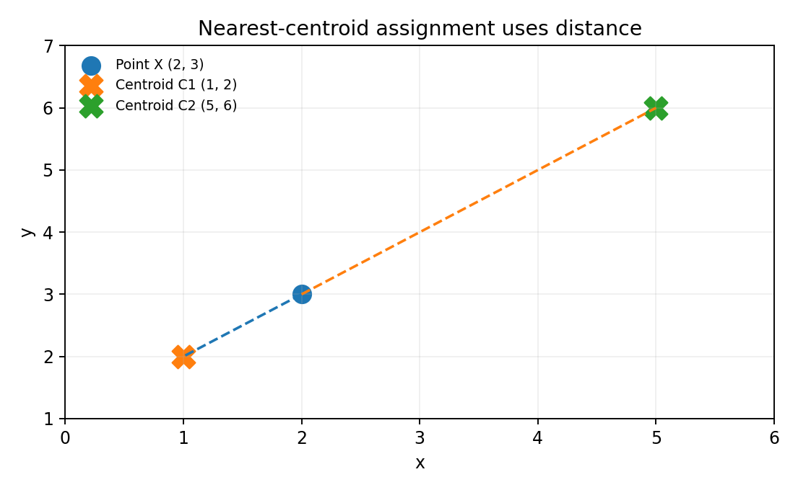
K-MEANS CLUSTERING
3. Mathematics: Euclidean distance
For numerical features, K-Means commonly uses Euclidean distance.
For p features
d(X, C) = √Σᵣ (xᵣ − cᵣ)²
Example
X = (2, 3)
C₁ = (1, 2) → d = √2 ≈ 1.41
C₂ = (5, 6) → d = √18 ≈ 4.24
Decision
Assign X to C₁ because it is closer.
UNSUPERVISED LEARNING • CUSTOMER SEGMENTATION
8

Slide 9
K-MEANS CLUSTERING
3. Mathematics: calculating a centroid
A centroid is the mean of the observations assigned to a cluster.
Centroid formula
μₖ = (1 / nₖ) Σ Xᵢ
Points: (2, 4), (4, 6), (6, 8)
Mean x = (2 + 4 + 6) / 3 = 4
Mean y = (4 + 6 + 8) / 3 = 6
Updated centroid
μ = (4, 6)
UNSUPERVISED LEARNING • CUSTOMER SEGMENTATION
9

Slide 10
K-MEANS CLUSTERING
3. Mathematics: objective function (WCSS)
K-Means tries to minimize the total squared distance from each point to its assigned centroid.
J = Σₖ Σ₍Xᵢ ∈ Cₖ₎ ||Xᵢ − μₖ||²
• Cₖ is the set of observations assigned to cluster k.
• μₖ is the centroid of cluster k.
• The squared distance measures how far an observation is from its cluster center.
• In scikit-learn, inertia_ reports this within-cluster sum of squares.
Important
WCSS decreases as K increases, so do not choose K using inertia alone.
UNSUPERVISED LEARNING • CUSTOMER SEGMENTATION
10

Slide 11
K-MEANS CLUSTERING
4. K-Means algorithm
Assignment and centroid-update steps repeat until convergence.
• Input dataset X and cluster count K.
• Initialize K centroids (preferably K-Means++).
• Assign each point to its nearest centroid.
• Recompute each centroid using the feature-wise mean.
• Check convergence; repeat if needed.
• Return labels, centroids, and WCSS.
INPUT: X, K
Initialize K centroids
REPEAT:
Assign points to nearest centroid
Recalculate each cluster mean
UNTIL convergence or max iterations
OUTPUT: labels, centroids, WCSS
Convergence
The objective does not increase during standard assignment/update steps.
UNSUPERVISED LEARNING • CUSTOMER SEGMENTATION
11

Slide 12
K-MEANS CLUSTERING
Why does K-Means converge—and what can go wrong?
The algorithm stabilizes, but may only reach a local optimum.
Assignment step
Update step
Local optimum
For fixed centroids, assigning each point to its nearest center minimizes squared distances.
For fixed assignments, the mean minimizes the sum of squared distances.
Different initial centers can produce different results.
• Use K-Means++, multiple starts, and a fixed random_state for reproducible teaching examples.
• K-Means works best for compact, reasonably separated numeric clusters; it is sensitive to outliers and feature scale.
UNSUPERVISED LEARNING • CUSTOMER SEGMENTATION
12

Slide 13
K-MEANS CLUSTERING
Hands-on project: customer segmentation
The included customers.csv contains 500 synthetic customer profiles.
CustomerID
Age
Annual Income
Unique identifier; do not use it as a clustering feature.
Customer age in years.
Annual income in rupees.
Spending Score
Project goal
A score from 1 to 100.
Find groups with similar numerical profiles, then describe them.
Synthetic data for practice—not real customer records.
UNSUPERVISED LEARNING • CUSTOMER SEGMENTATION
13

Slide 14
K-MEANS CLUSTERING
Python implementation 1 — load and inspect
Keep customers.csv in the same working directory as your notebook or script.
import pandas as pd
df = pd.read_csv("customers.csv")
print(df.head())
print(df.info())
print(df.describe())
features = [
"Age",
"Annual Income",
"Spending Score"
]
X = df[features].dropna()
Inspect first
Confirm column names, data types, ranges, and missing values.
Exclude CustomerID
IDs identify rows; they do not represent customer behavior.
UNSUPERVISED LEARNING • CUSTOMER SEGMENTATION
14

Slide 15
K-MEANS CLUSTERING
Python implementation 2 — scale and fit
Scaling helps stop features with large numeric ranges from dominating Euclidean distance.
from sklearn.preprocessing import StandardScaler
from sklearn.cluster import KMeans
scaler = StandardScaler()
X_scaled = scaler.fit_transform(X)
model = KMeans(
n_clusters=4,
init="k-means++",
n_init=10,
random_state=42
)
labels = model.fit_predict(X_scaled)
df_clustered = df.loc[X.index].copy()
df_clustered["Cluster"] = labels
print("Inertia:", model.inertia_)
print("Iterations:", model.n_iter_)
n_clusters = 4
Example only—compare candidate values of K.
n_init = 10
Run multiple initializations and keep the best fit.
random_state = 42
Makes initialization reproducible.
UNSUPERVISED LEARNING • CUSTOMER SEGMENTATION
15

Slide 16
K-MEANS CLUSTERING
Python implementation 3 — evaluate and profile
Use metrics alongside cluster summaries to decide whether the segmentation is useful.
from sklearn.metrics import silhouette_score
print(
"Silhouette Score:",
silhouette_score(X_scaled, labels)
)
print(
df_clustered.groupby("Cluster")[
["Age", "Annual Income", "Spending Score"]
].mean().round(1)
)
print(
df_clustered["Cluster"].value_counts().sort_index()
)
Silhouette score
Ranges from −1 to +1; higher is generally better for comparable candidates.
Cluster averages
Reveal the typical age, income, and spending profile for each group.
UNSUPERVISED LEARNING • CUSTOMER SEGMENTATION
16

Slide 17
K-MEANS CLUSTERING
Python implementation 4 — visualize the clusters
Plot annual income against spending score to inspect two dimensions at once.
import matplotlib.pyplot as plt
plt.figure(figsize=(8, 5))
plt.scatter(
df_clustered["Annual Income"],
df_clustered["Spending Score"],
c=labels,
cmap="viridis",
s=45,
alpha=0.8
)
plt.xlabel("Annual Income (₹)")
plt.ylabel("Spending Score")
plt.title("Customer Segmentation using K-Means")
plt.tight_layout()
plt.show()
Read the plot
Look for groups with distinct income and spending patterns.
Remember
This plot shows two features; the model was trained on three.
UNSUPERVISED LEARNING • CUSTOMER SEGMENTATION
17

Slide 18
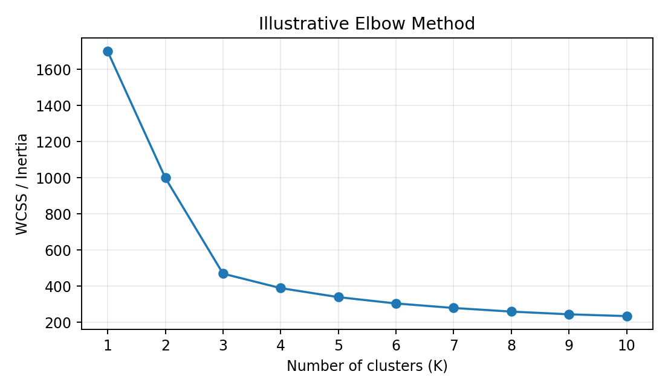
K-MEANS CLUSTERING
Optional — choose K with the Elbow Method
Compare inertia across several candidate values of K.
inertias = []
k_values = range(1, 11)
for k in k_values:
model_k = KMeans(
n_clusters=k,
n_init=10,
random_state=42
)
model_k.fit(X_scaled)
inertias.append(model_k.inertia_)
plt.plot(k_values, inertias, marker="o")
plt.xlabel("K")
plt.ylabel("Inertia")
plt.show()
Choose a bend where extra clusters give smaller improvements; confirm with silhouette and domain knowledge.
UNSUPERVISED LEARNING • CUSTOMER SEGMENTATION
18

Slide 19
RECAP & PRACTICAL CHECKLIST
From algorithm to useful customer insights
• K-Means alternates nearest-centroid assignment and mean-based updates.
• Its objective is to minimize within-cluster squared distances (WCSS).
• Scaling, initialization, outliers, and the choice of K influence results.
• Use the Elbow Method, silhouette score, and cluster profiles together.
• Interpret the segments in the context of the customer/business problem.
Files needed: this presentation + customers.csv
UNSUPERVISED LEARNING • CUSTOMER SEGMENTATION
19

